Slide 1
Your B-1 and How to use it: Year 4 and the core 34 Diana Blackwell, Board & Special Initiatives (BSIC) Lori Slayton, Adult Education & Literacy

Slide 2
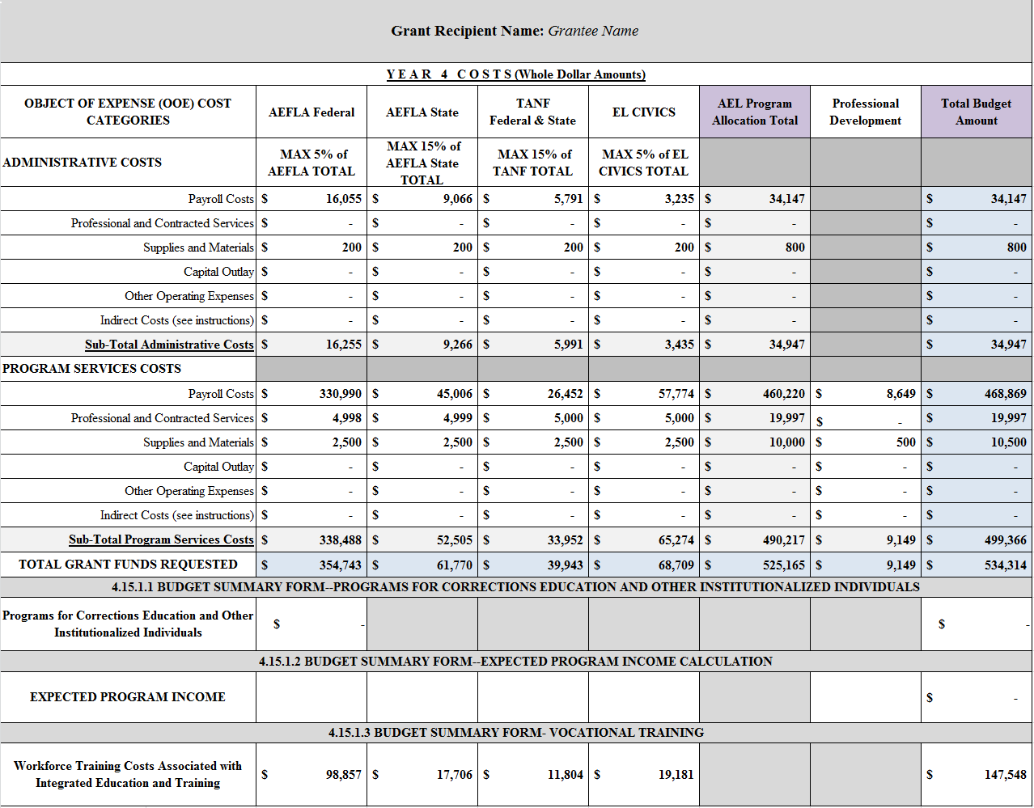
SAMPLE Attachment B-1 Year 4 (Budget Form)

Slide 3
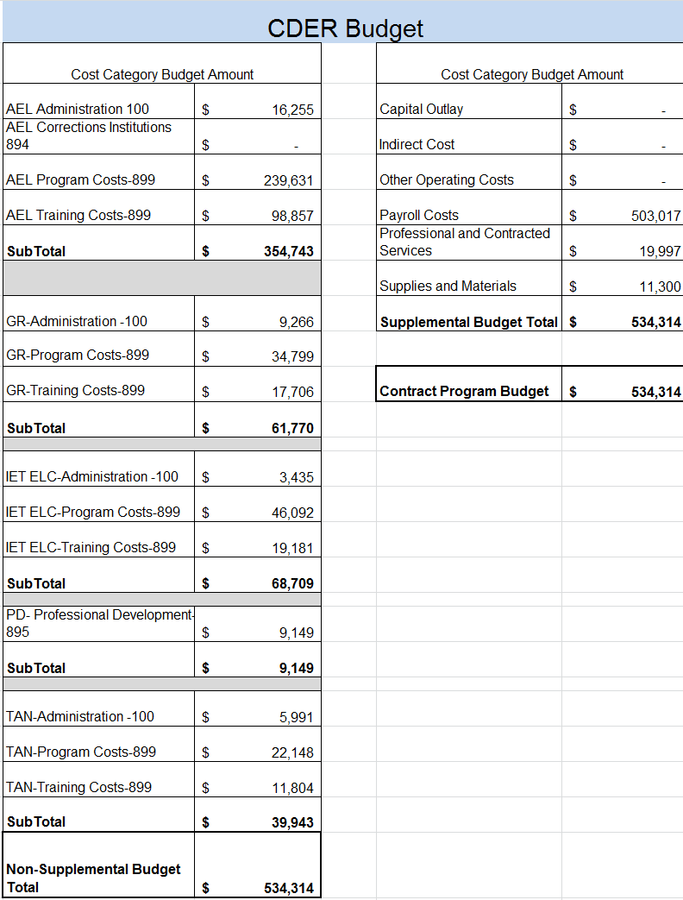
B-1 CDER View Tab

Slide 4
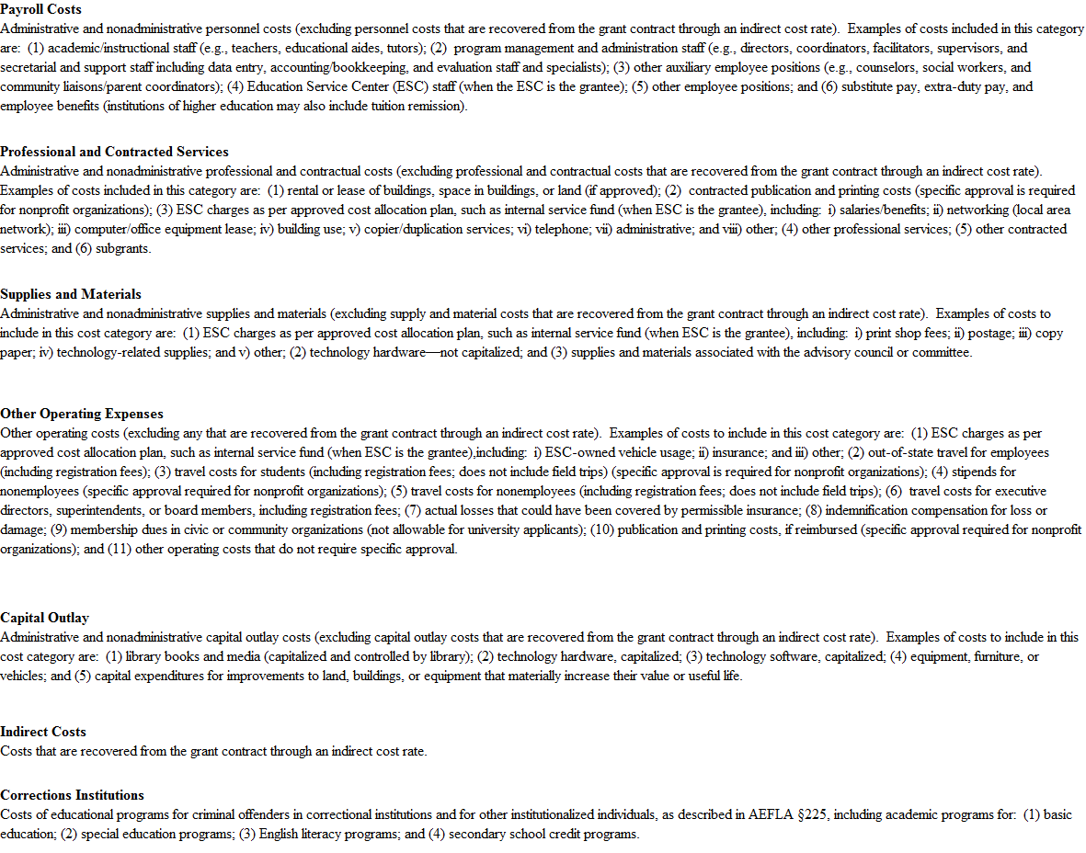
B-1 Cost Category Descriptions Tab

Slide 5
Budget Adjustments vs. Budget Amendments
New language allows for moving an aggregate amount of less than or equal to 20% without needing an amendment.
A change in the amount of a budget line item or combination of line items in which the aggregate change is less than twenty percent (20%) of the total grant award may be approved by the contract manager at their discretion, and may not require a budget amendment.

Slide 6
Budget Adjustments vs. Budget Amendments
Budget Adjustment
Budget Amendment
Moving a sum that is less than 20% of the aggregate amount
Contact your CM in writing for latest budget
Submit Revised Attachment B-1 with changes highlighted or in bold
Moving a sum that is more than 20% of the aggregate amount
Contact your CM in writing for full process and latest budget and forms
Submit Contract Action Request (CAR)
Submit Revised Attachment B-1 with changes highlighted or in bold

Slide 7
Budget Adjustments vs. Budget Amendments
Budget Adjustment
Budget Amendment
Requires TWC Contract Manager approval
Changes in CDER usually completed the same day
Email with CDER confirmation screenshot will be sent
Process takes between 1 hour -2 days (depending on workload)
Requires TWC Contract Manager approval
Requires TWC leadership approval
Requires amendment process concluding in party signatures
Changes in CDER completed after amendment is executed
Process takes between 2-4 weeks

Slide 8
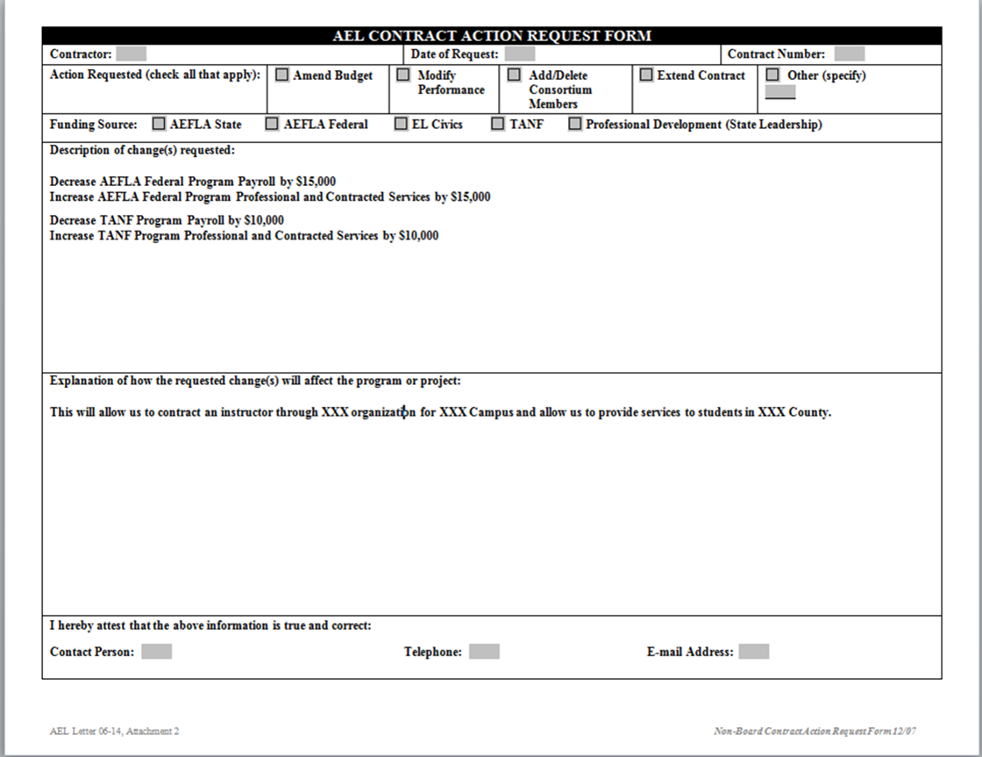
SAMPLE Contract Action Request Form (CAR)

Slide 9
Budget Adjustments vs. Budget Amendments
Submit questions and/or requests to: aelcontracts@twc.state.tx.us & COPY both your Contract Manager and your AEL Program Specialist.

Slide 10
Cost Categories

Slide 11
AEL Cost Category Types
Regular
Administration
Program
Personnel/Salary
Fringe Benefits
Travel
Equipment
Supplies
Professional & Contracted Services
Other operating expenses
Notes:
Lori: Very brief overview – next slide covers in depth
Multiple cost categories are used to capture information about grant award costs. Some of these categories capture information that TWC needs for federal and state reporting purposes. All of these cost categories fall into two broad groups—regular and supplemental cost categories.
Regular Cost Categories
There are two types of regular cost categories.
Administration: There is a small group of categories that are reserved for use in reporting administrative costs.
In general, administrative costs are costs associated with the overall administration and management of a program or project. Some grant award contracts could be exclusively administrative in nature, but most are awarded to carry out all or part of a program. When a grant award contract is made to carry out programmatic activities, the expectation is that the majority of funds will be used for that activity. For that reason, most grant contracts contain an administrative cost limit or “cap”. Depending on the program and project, the cap is defined by funding source, AEL Rules, TWC regulations and policies. Admin caps can be found at the top of your B-1 for each funding source.
Program (Non-administrative): A much larger group of cost categories exist for reporting program costs, such as those associated with the development of programmatic information systems, services that are referred to as direct program costs, supportive services, and other miscellaneous program costs. These can also include costs associated with training staff on programmatic requirements, providing programmatic technical assistance, the development and operation of programmatic tracking systems, as well as space, utility, supply, and equipment costs associated with providing program services.
In short, all costs that are not administrative costs are program costs.
Note that both administrative and program costs can be either direct or indirect (or allocated) costs. A common misconception is that indirect costs are limited to costs that result from an indirect cost rate and that such costs are always administrative costs. While most costs that result from an indirect cost rate are administrative in nature, that is not always the case. If an entity analyzes its indirect cost rate and finds that it contains programmatic costs, it could identify the percentage share of the rate that consists of program costs, and exclude those costs from administrative costs and limits. Again, such charges would be based on analysis of the individual costs in the indirect cost pool. It is not acceptable to distribute the indirect cost rate between administrative and program costs based on a ratio of total administrative costs to total program costs, or other rationale.
In addition to indirect costs that result from an indirect cost rate, an entity might have costs that jointly benefit and are allocated among two or more programs or projects, or types of activities. Examples of allocated administrative costs are accounting and audit costs that jointly benefit two or more programs or projects. Examples of allocated program costs are outreach, intake, and assessment if a single activity simultaneously targets or serves multiple programs. Another example of allocated program costs are those associated with a resource room that is available for use by multiple programs. As a final example, space, utility, supply, and equipment are examples of costs that an entity might allocate between administrative and program costs when the associated space or resources are shared between administrative and program activities.
Supplemental Cost Categories
Supplemental cost categories are used to re-state certain or all reported expenditures to provide additional detail about the costs incurred. Core 34 AEL contracts have multiple supplemental cost categories, although other AEL contracts may have different supplemental categories and some may have none.
Program specific: Program specific cost categories usually capture specific additional programmatic information that TWC needs in order to complete federal and state expenditure reports. There are a limited number of program-specific supplemental cost categories.
Functional: Functional cost categories re-state reported expenditures by object of expense, such as personnel, travel, equipment, and the like.

Slide 12
AEL Regular Cost Categories
Administration
Personnel
Fringe Benefits
Travel
Equipment
Supplies
Professional & Contracted Services
Other Operating Expenses
Notes:
Lori: Personnel – Salaries and Wages): these are the line items on your B-1 broken down by admin and program
Salaries and wages for AEL program full- and part-time employees’ non-administrative activities on the grant contract. *note – this does NOT include salary for sub-contracted employees, which should be reported under P&C
Fringe Benefits (or Personnel Benefits)
Fringe benefits for AEL employees’ non-administrative activities on the grant contract; e.g. employer contributions or expenses such as social security, employee insurance, workmen's compensation insurance and pension plan costs. *again – NOT for sub-contracted staff
Travel
Travel expenses incurred for AEL employees to carry out official non-administrative business of the grant contract.
Equipment
Include the cost of equipment, as defined by Appendix A to the Financial Manual for Grants and Contracts—i.e., an article of non-expendable, tangible, personal property having a useful life of more than one year, and an acquisition cost of $5,000 or more—that is used to carry out non-administrative activities under the grant contract. Approval must be obtained through the contract’s designated contract manager prior to purchasing equipment.
***need citation for reporting equipment at closeout
Supplies
Tangible personal property, other than that included in the Equipment cost category, used to carry out non-administrative activities under the grant contract.
*Supplies must be ordered and received prior to the end date of the grant.
Professional & Contracted Services
Contracted services—including, but not limited to sub-contracts, and contracts for temporary employment services, utilities, telephone, printing/duplication services, maintenance and repair services, janitorial services, and space rental—that are used to carry out non-administrative activities under the grant contract.
*anything you have a signed commitment to pay – a legally established debt (remember reporting obligations, earlier)
Other Operating Expense
Other non-administrative costs to carry out the grant contract.
*if you are unsure where to place a particular cost, please contact your Contract Manager and Program Specialist so they can help you make an informed decision, don’t guess!

Slide 13
SAMPLE Attachment B-1 Year 4 (Budget Form)

Slide 14
AEL Supplemental Categories
Your B-1 CDER tab and reported in CDER
Capital Outlay
Indirect
Other Operating Costs
Payroll
Professional & Contracted Services
Supplies/Materials

Slide 15
B-1 CDER View Tab

Slide 16
COST ALLOCATION
200.4 Allocation
Allocation means the process of assigning a cost, or a group of costs, to one or more cost objective(s), in reasonable proportion to the benefit provided or other equitable relationship. The process may entail assigning a cost(s) directly to a final cost objective or through one or more intermediate cost objectives.

Slide 17
COST ALLOCATION
Cost allocation process
Avoid frequently found mistakes, some errors that result in an improper allocation of costs include:
Lack of a written cost allocation plan
Failure to follow a cost allocation plan
Staff time not being allocated across multiple programs or funds being worked on
Costs are being allocated based on funding projections or budgets without subsequent adjustment

Slide 18
AEL LETTER 04-15 – COST ALLOCATION
AEL entities must be aware that per FMGC, Chapter 11: As provided in applicable cost principles, “All costs and other data used to distribute the costs in the plan should be supported by formal accounting and other records that will support the propriety of the costs assigned to federal or state awards.”

Slide 19
COST OBJECTIVES
200.28 Cost Objective
A program, function, activity, award, organizational subdivision, contract, or work unit for which cost data are desired
May be a major function, particular service or product, Federal award, or an indirect cost activity
A Cost Objective is a program, function, activity, award, organizational subdivision, contract, or work unit for which cost data are desired. It may be a major function, particular service or product, Federal award, or an indirect cost activity

Slide 20
COST ALLOCATION
200.405 Allocable Costs
A cost is allocable to a particular Federal award or other cost objective if the goods or services involved are chargeable or assignable to that Federal award or cost objective in accordance with relative benefits received. This standard is met if the cost:
Is incurred specifically for the Federal award;
Benefits both the Federal award and other work of the non-Federal entity, and can be distributed in proportions that may be approximated using reasonable methods; and
Necessary to the operation of non-Federal entity.

Slide 21
COST ALLOCATION PLAN
The method used to document the allocation of direct costs is the Cost Allocation Plan, commonly referred to as a CAP. Every recipient and sub-recipient must have a CAP.
If your institution does not have a Cost Allocation Plan, please contact your Contract Manager to assist you with this.

Slide 22
COST ALLOCATION PLAN
AEL Letter 04-15:
A certification that the cost allocation plan:
was prepared in accordance with the OMB Uniform Guidance, Grant Management Standards, and FMGC;
contains only allowable costs;
was prepared in a manner that treated similar costs consistently among the various federal or state awards and between federal and other nonfederal awards and activities
an authorized official of the organization must certify that the cost allocation plan has been prepared in accordance with authorizing legislation and regulations, and state or other applicable requirements.

Slide 23
SAMPLE Required Cost Allocation Plan
Cost Allocation Plan Certification
This is to certify that I have reviewed the cost allocation plan submitted herewith, and to the best of my knowledge and belief:
All costs included in this proposal, dated , to establish cost allocations or billings for [enter period covered by plan] are allowable costs in accordance with the requirements of OMB Circulars A-21, A-87, A-122, Uniform Grant Management Standards, the Texas Workforce Commission’s Financial Manual for Grants and Contracts, and the federal and state awards to which they apply. Unallowable costs have been adjusted for in allocating costs as indicated in the cost allocation plan.
All costs included in this proposal are properly allocable to federal or state awards on the basis of a beneficial or causal relationship between the expenses incurred and the awards to which they are allocated, in accordance with applicable requirements.
Further, the same costs that have been treated as indirect costs have not been claimed as direct costs. Similar types of costs have been accounted for consistently.
I declare the foregoing is true and correct:
Organization:
Official’s Name:
Official’s Title:
Date of Execution:
Signature: __ _____________________________

Slide 24
B-1’s, Year 4 and the Core 34
This is the end of this section – we will cover more on AEL Contracts after the break, but right now…..it’s POP QUIZ, HOT SHOT!

